Slide 1
Distribution System Bad Data Detection Using Graph Signal Processing
Jagdish Meghwal
230140054
M.Tech (Power Engineering)

Slide 2
content
Introduction
Graph Signal Processing
How T-SNE works?
How DBSCAN works?
Experiment Setup of original paper
My Experiment Setup
Analysis

Slide 3
Introduction
Large-scale deployment of smart meters has revolutionized the collection of data in electricity distribution systems. However, the reliability of this data is threatened by abnormalities such as malfunctioning meters or lost communications.
In my term paper I studied a paper related to bad data detection of distribution system using graph signal processing.
Then as per my understanding, I tried to replicate that result during my work.
Let’s discuss the method that were used in the paper and I implemented during my work as well.

Slide 4
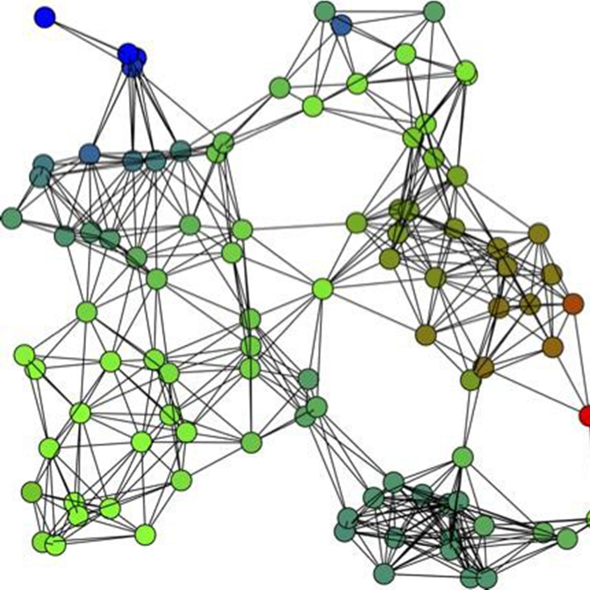
Graph Signal Processing
A graph is defined by a set of N nodes or vertices V ∈ [v1, ..., vN ] connected by M edges E ∈ [e1, . . . , eM].
The adjacency matrix A of a graph= symmetric matrix with the ijth element aij = 1 (if eij exists, otherwise 0).
An extension of the adjacency matrix is the weight matrix W, in which the wij may assume some value relating to the strength of the connection between nodes i and j.
The degree matrix D is a diagonal matrix wherein the entries dii are defined as the sum of all weights related to node i: dii
With the help of D and W, ,Laplacian can be created for a graph that is L= D-W
By this a graph fourier transform of the Laplacian matrix can be found to create a spectral signal.

Slide 5
With respect to Distribution system
Nodes= Measurement nodes
Nodal signal= Voltage magnitude measurements
Then the graph fourier transform was created for different buses.
Then a method for embedding is used to reduce high dimensionality data into low dimensionality data.
t-SNE((t-distributed Stochastic Neighbor Embedding)- t-SNE (t-distributed Stochastic Neighbor Embedding) is a dimensionality reduction technique used primarily for visualizing high-dimensional data in a lower-dimensional space, typically two or three dimensions. It aims to capture the underlying structure of the data by preserving local similarities between data points.
Then clustering was done of the t-sne data with DBSCAN to analysis the data with the help of clusters.
DBSCAN stands for Density-Based Spatial Clustering of Applications with Noise. It's a popular clustering algorithm used in machine learning and data mining for identifying clusters of points in a dataset. DBSCAN does not require the number of clusters to be specified in advance, making it particularly useful for datasets where the number of clusters is not known beforehand or where the clusters have varying shapes and densities.

Slide 6
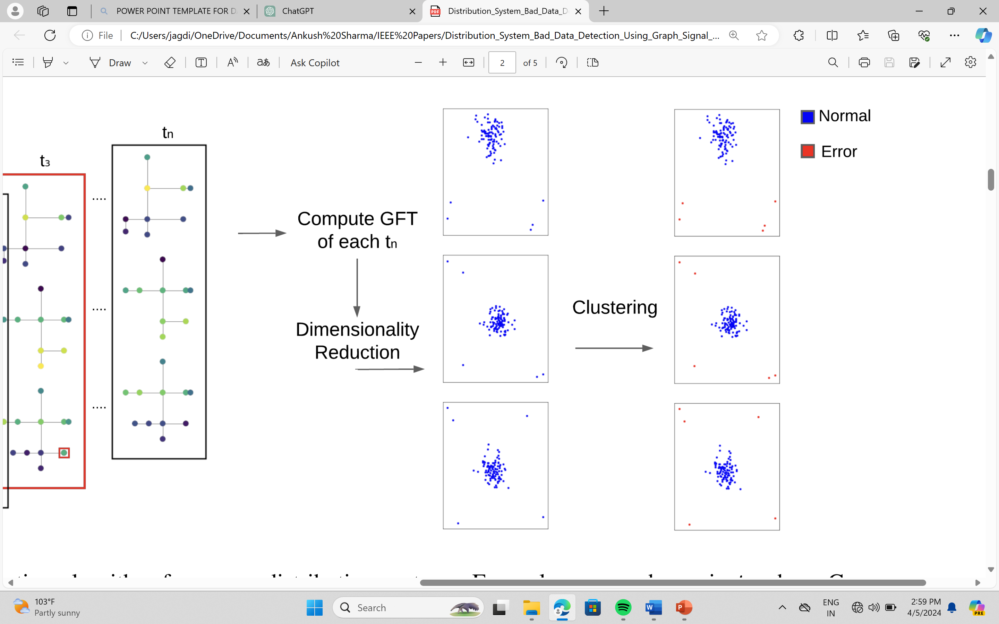
Here's how t-SNE works:
1. Similarity Calculation
2. Mapping to lower dimensionality
3. Preservation of local structure

Slide 7
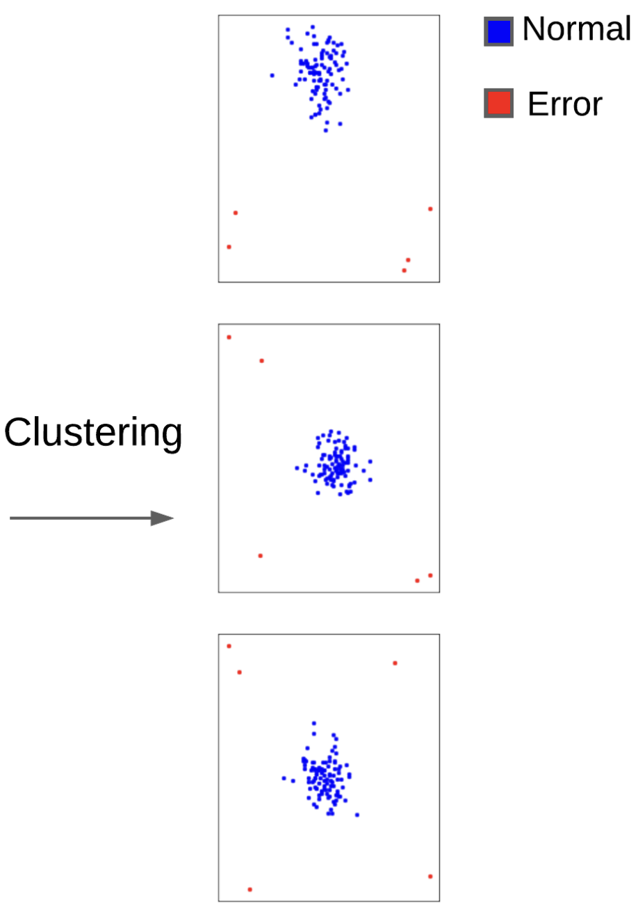
Here's how DBSCAN works:
1. Density Based Clustering
2. Border Points
3. Noise points
4. Resulting Clusters

Slide 8
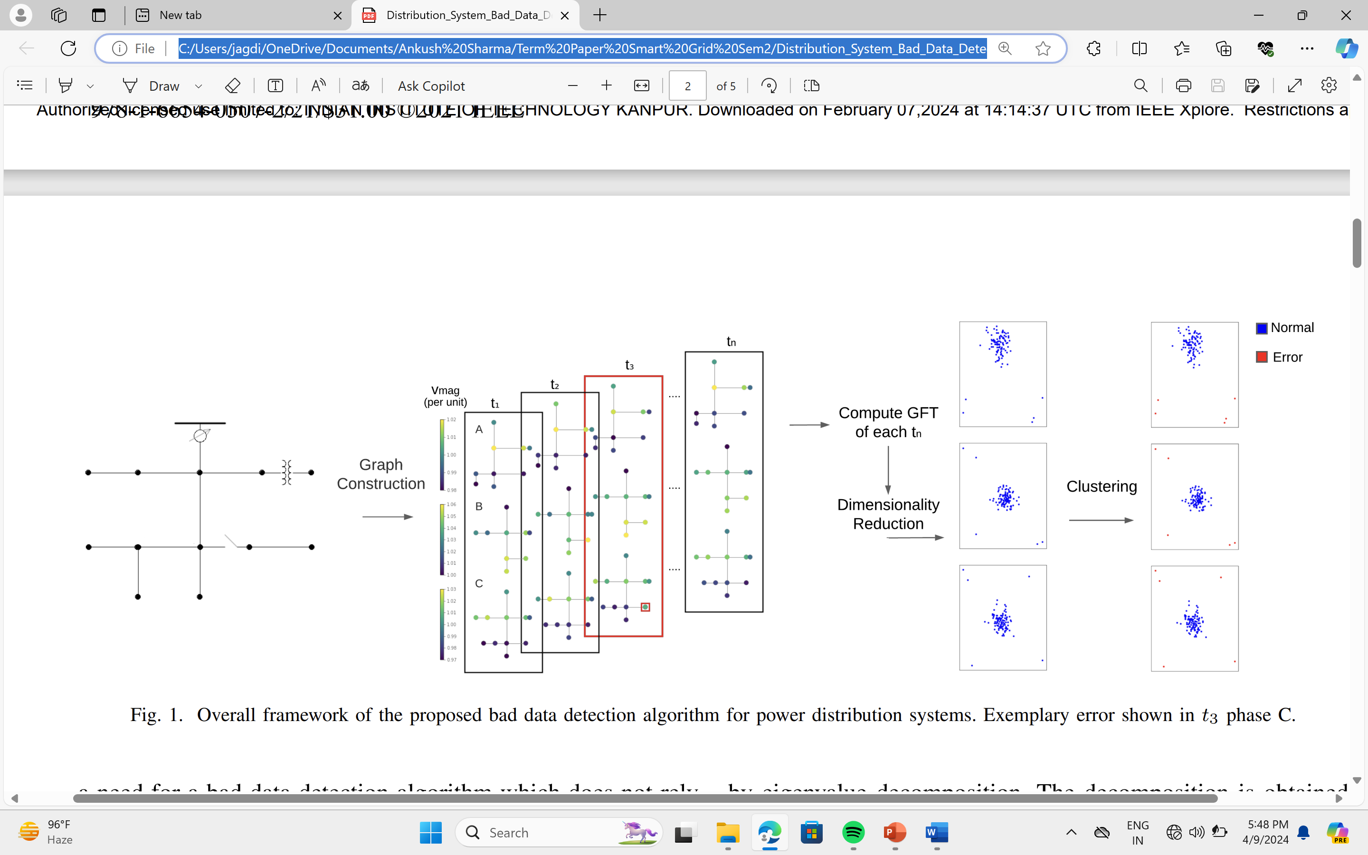
Experiment setup of original paper
1. Data Preparation
2. Adding noise
3. Test scenarios
4. Dimensionality Reduction
5. Cluster Identification

Slide 9
My experiment setup
A time series 3 phase data of each minute of voltages is chosen with some errors in magnitude.
Then the graph fourier transform of each phase is found out separately.
A large amount of data is there so t-SNE is performed on the graph fourier transform.
Then the clustering of the embedding data is done to visualize the data efficiently.

Slide 10
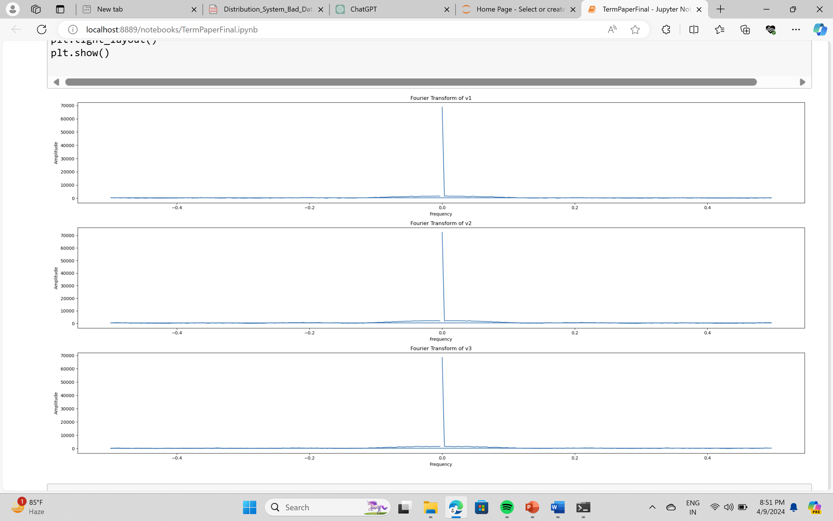
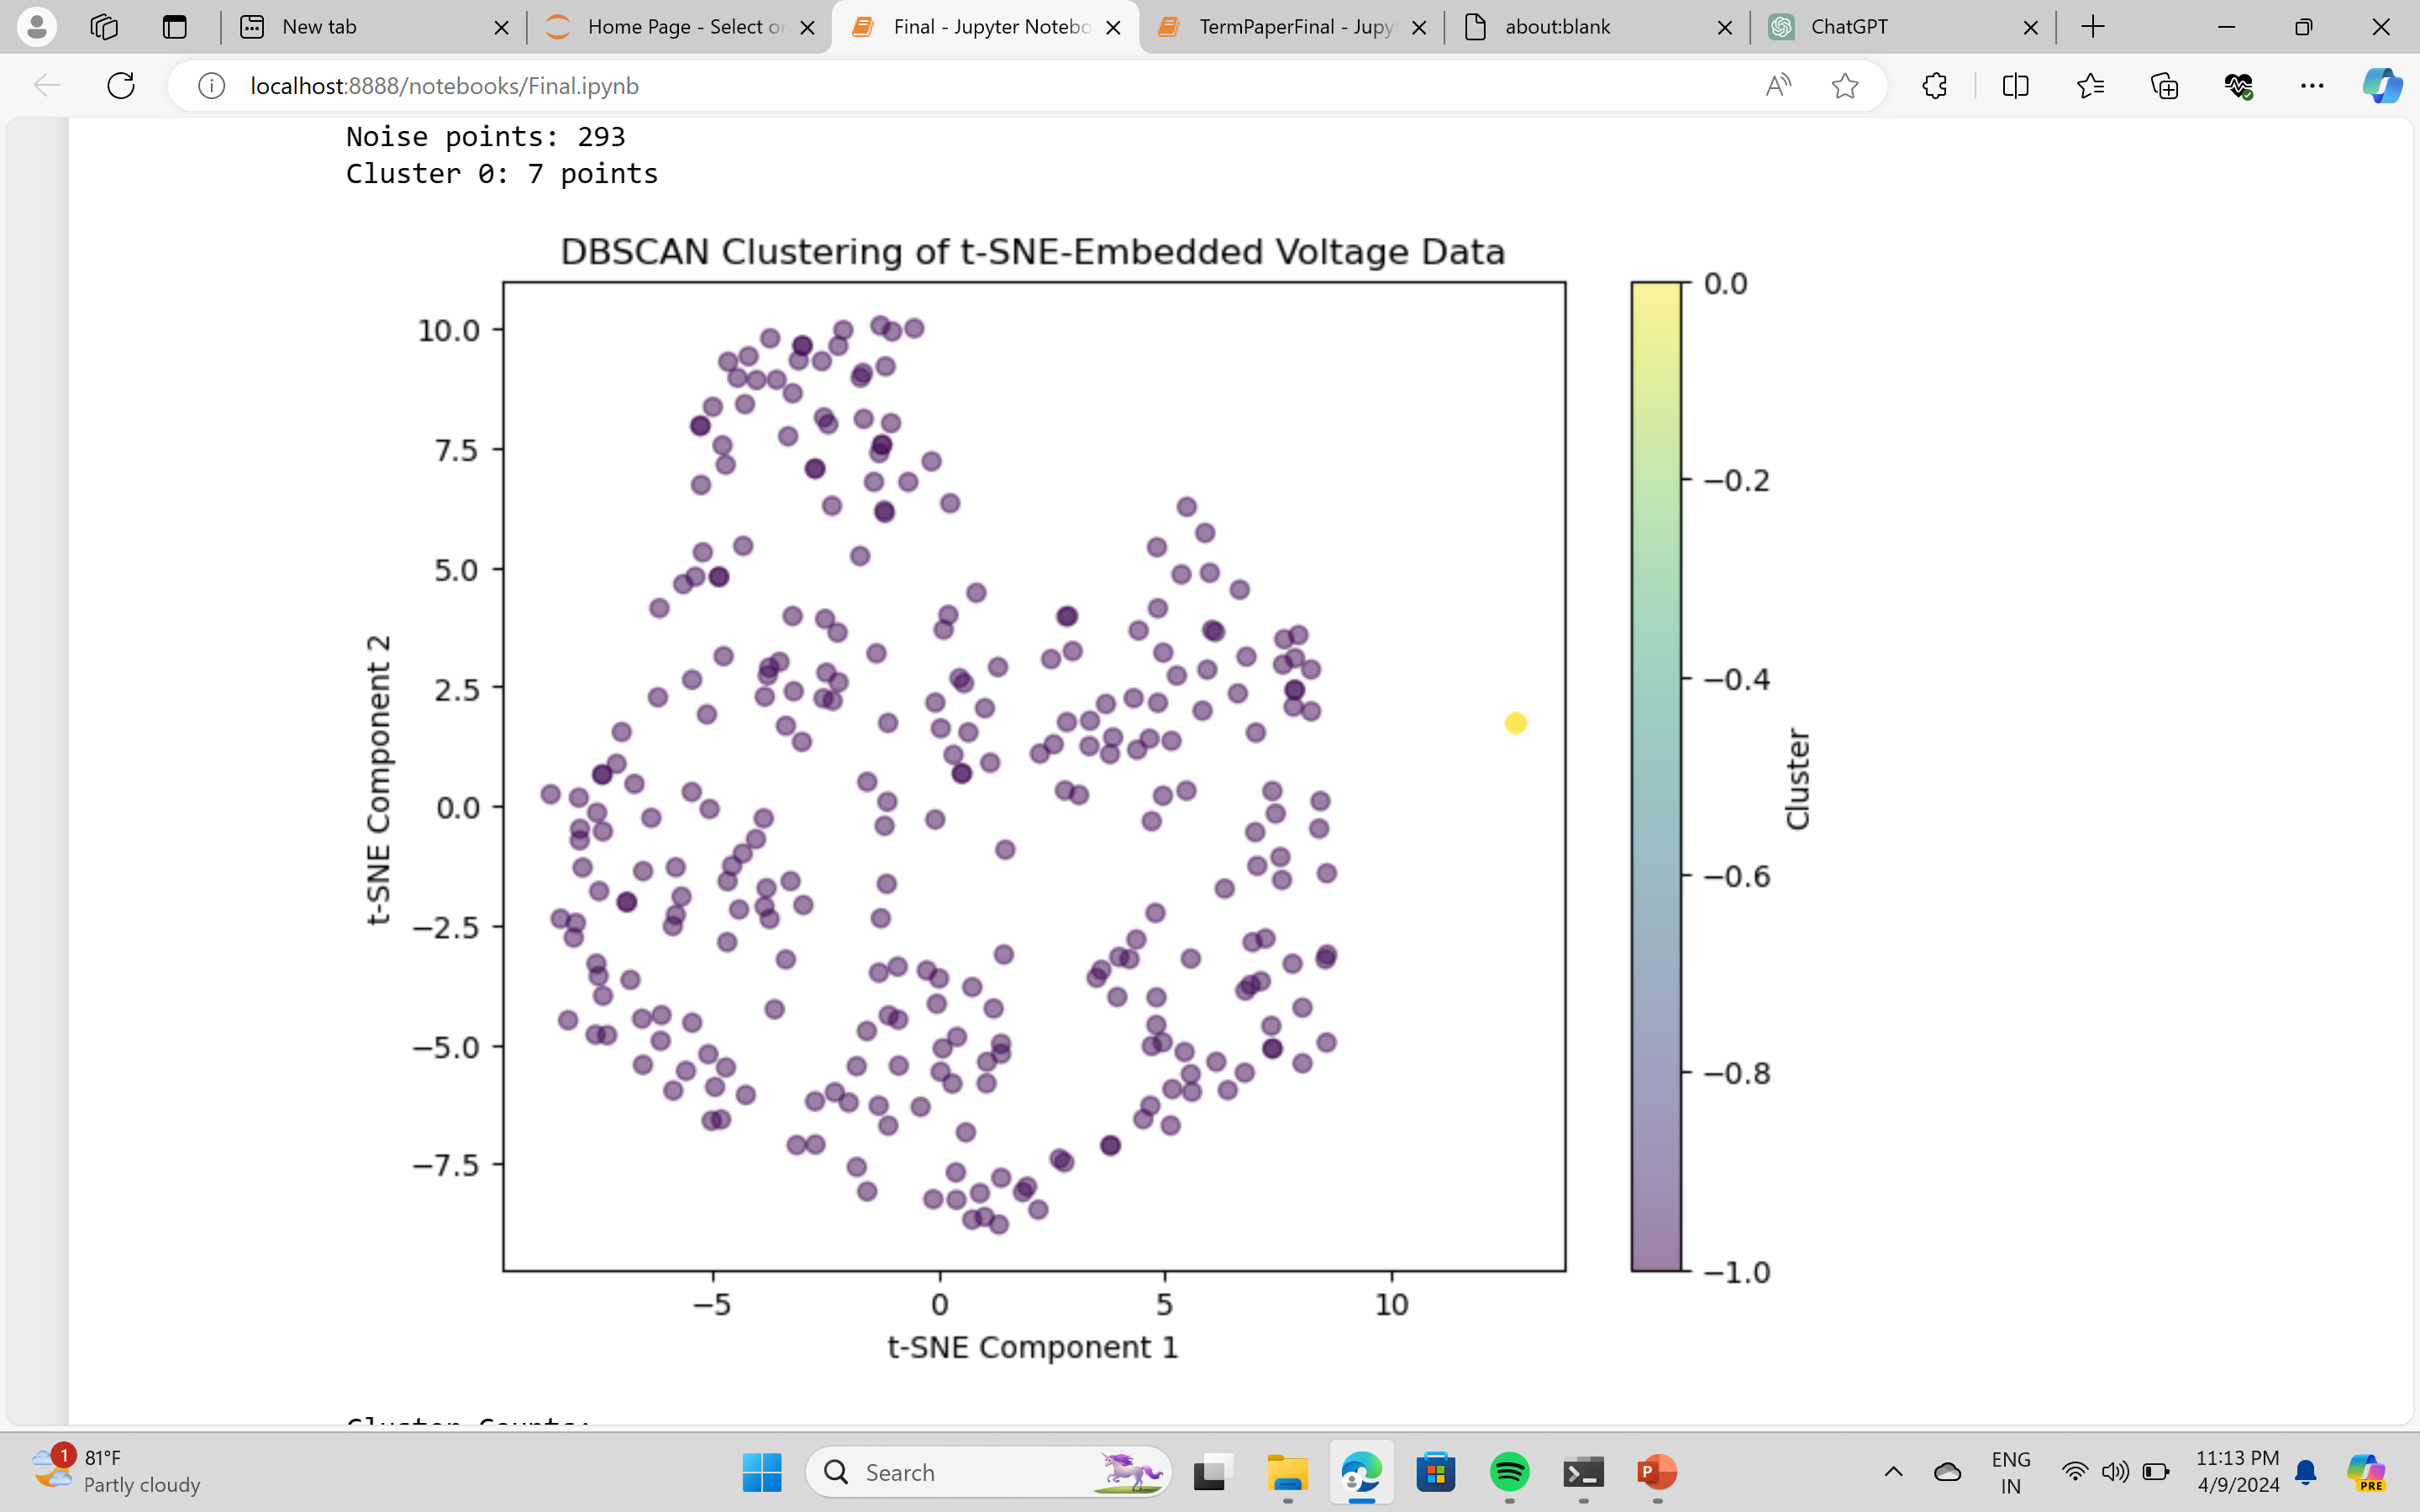

Slide 11
Analysis
Cluster -1:
Number of points: 293
Mean values: v1
234.934369
v2 234.315119
v3 237.577691
Standard deviation:
v1 8.674962
v2 8.651737
v3 8.458040
Cluster 0:
Number of points: 7
Mean values:
v1 2.142857
v2 549.767143
v3 2.571429
Standard deviation:
v1 1.069045
v2 30.082107
v3 1.272418

Slide 12
Thank you!
Reference- Osten Anderson, and Nanpeng Yu, “Distribution System Bad Data Detection Using Graph Signal Processing,”
Department of Electrical and Computer Engineering University of California, Riverside, CA, 2018

